Slide 1

Comparison of Search-based and Reinforcement Learning Agents in Solving the Game of Snake
Presented by:
ANJALI YADAGIRI
VENKAT GOUD RAJULAPATI
MARY PRAVANYA NETTEM

Slide 2
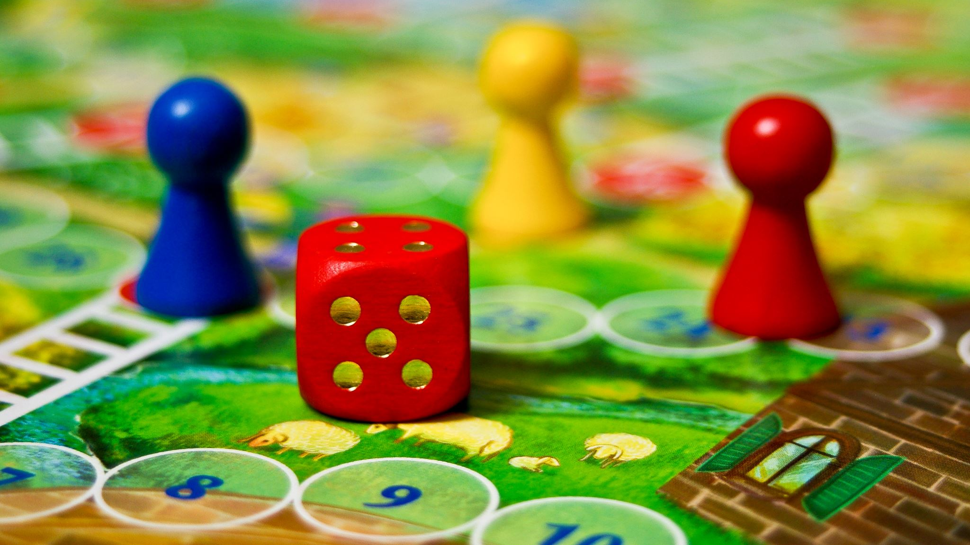
Project Topic
The game is typically played using four arrow keys. The snake starts moving when the game is started, we need to guide the snake towards food by turning it to the left or right without colliding with borders or running into itself.
The food is randomly generated in the environment. Once the food is eaten by the snake its size increases.

Slide 3
Statement of project objectives
The primary objective of this project is to control the snake in a restricted environment. The snake needs to eat the food and on other hand it should avoid colliding with screen borders or even running into itself. As the snake eats the food it is increased in size.
The project main goal is to achieve the maximum score by collecting the food without snake colliding with walls or eventually running into itself.
Here we use Search-based and Reinforcement Learning Agents to compare their performances and achieving the optimal results.

Slide 4

Approach
Search-based: breadth first search uses manhattan distance to calculate the shortest path.
Reinforcement learning (RL): is an area of machine learning concerned with how software agents ought to take actions in an environment in order to maximize the notion of cumulative reward
OpenAI Gym: A toolkit for developing and comparing reinforcement learning algorithms.
Python programming language.
Pycharm editor.

Slide 5

Search based Algorithm
The algorithm solves the problems by searching through a set of possible solutions.
There are two types informed and uninformed
Here we are using A* algorithm from informed search

Slide 6
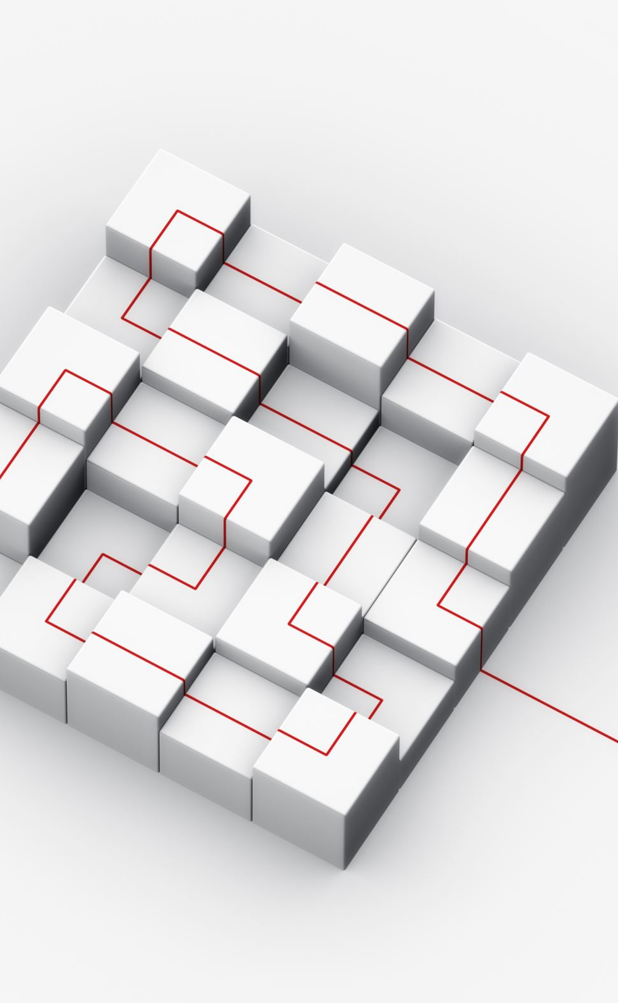
Reinforcement Learning
Reinforcement learning is the training of machine learning models to make a sequence of decisions.
Reinforcement learning (RL) is an area of machine learning concerned with how software agents ought to take actions in an environment in order to maximize the notion of cumulative reward.

Slide 7

Objectives
A* Search Algorithm
A* Search Algorithm is often used to find the shortest path from one point to another point. A* is often used for the common pathfinding problem in applications such as video games, but was originally designed as a general graph traversal algorithm.
Q learning algorithm
Q-learning is a model-free reinforcement learning algorithm to learn a policy telling an agent what action to take under what circumstances.
Q-Learning is a value-based reinforcement learning algorithm which is used to find the optimal action-selection policy using a Q function.

Slide 8
Difference between A* algorithm and Q learning algorithm
A* algorithm is used for pathfinding problems, while Q-learning algorithm is used for control problems.
A* algorithm is an informed search algorithm that uses a heuristic function to guide the search process, while Q-learning algorithm is a reinforcement learning algorithm that learns through interaction with the environment.
A* algorithm uses a graph or tree data structure to represent the search space, while Q-learning algorithm uses a Q-table to store the expected reward for each action in each state.

Slide 9
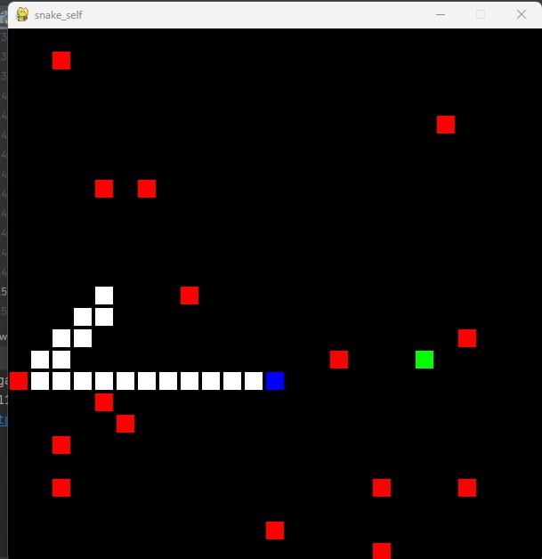
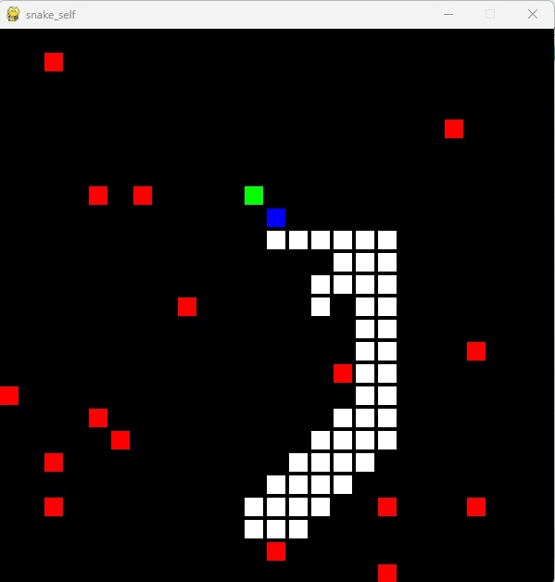
A*search Algorithm Result

Slide 10
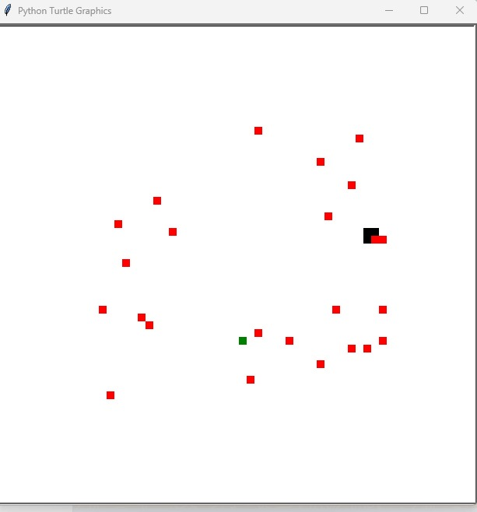
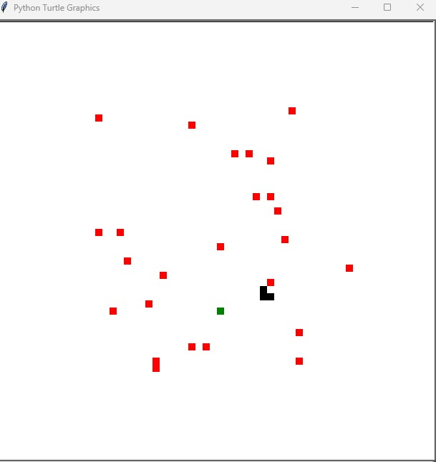
Q learning algorithm Result

Slide 11


Thank you

